Slide 1
//Build – The Good Parts
In one and One Half hour
https://github.com/jamessdixon/Trinug.MainMeeting.May2016

Slide 2
Top ANNOUCEMENTS At //Build/
Desktop App Converter
Xamarin/Visual Studio integration & Open Source announcement
Office opportunities for developers
Ubuntu & Bash on Windows
Windows 10 Anniversary Update
Digital Ink
Bots & Conversation (User Experience)
Xbox development mode
IoT announcement(s)
HoloLens shipping to developers
.NET Core
Service Fabric
Microsoft Cognitive Services

Slide 3
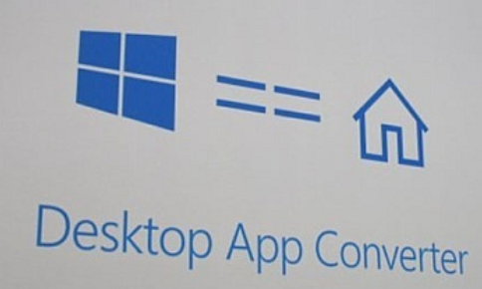
Desktop App Converter
Desktop App Converter (previously known as Project Centennial) allows developers to bring their desktop apps to Universal Windows Platform (UWP)
Convert Win32 & .NET desktop apps to UWP
It converts a desktop Windows installer such as MSI or exe to an AppX package that can be deployed to a Windows 10 desktop
https://msdn.microsoft.com/windows/uwp/porting/desktop-to-uwp-run-desktop-app-converter
https://www.microsoft.com/en-us/download/details.aspx?id=51691
https://channel9.msdn.com/events/build/2016/p504

Slide 4
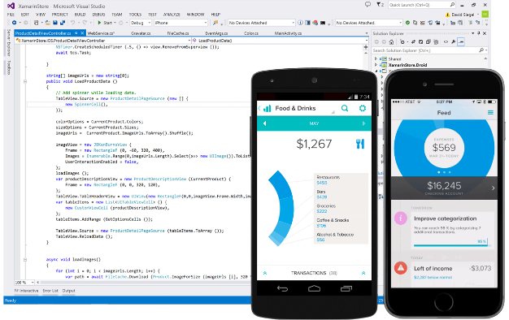
Xamarin – Oh Hell Yeah!
Allows Windows developers using .NET the native ability inside Visual Studio to write applications to Android and iOS
Using Xamarin’s SDK, devs use F# and/or C# to write apps that run on Apple & Google’s mobile platform
Microsoft acquired Xamarin earlier this year and is including it in Visual Studio at no additional cost
Microsoft is releasing Xamarin Studio (Mac app) for free as a community edition (to match VS Community Edition for the PC)
Xamarin Studio will be Microsoft’s permanent product for the Mac IDE
This is in addition to Visual Studio Code (free cross-platform editor for Windows, Mac & Linux)
Contributed the Mono Project to the .NET Foundation & will be re-released under the MIT license.
Will also open source the Xamarin SDKs for Android, iOS and Mac (includes native API bindings and basic command-like tools)
https://blog.xamarin.com/xamarin-for-all/
https://www.visualstudio.com/en-us/features/xamarin-vs.aspx

Slide 5

Office
Build smarter apps with Microsoft Graph and Office 365
Developers can use Microsoft Graph to access a user’s OOF and recent email attachments, new APIs to return “relevant documents” and suggestions for meeting times based on real-time calendar availability
OneDrive file picker makes it easy to access O365 data
Add-ins support for Office for Mac
Engage users through conversation
Skype Web SDK
Skype for Business App SDK
Office 365 Connectors (see separate slide in this presentation)
https://blogs.office.com/2016/03/31/office-at-build-2016-new-opportunities-for-developers/

Slide 6
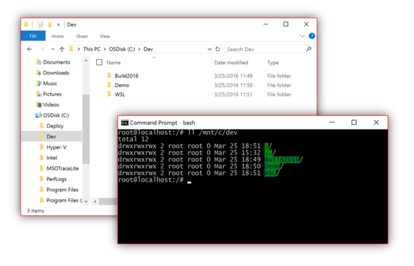
Bash On Windows
Ubuntu user-mode binaries provided by Canonical to bring Bash to the Windows environment
Makes it easier to run open-source tools on Windows (since many of the open source tools rely on Linux command-line)
Called the Windows Subsystem for Linux (WSL)
Can run command-line tools like sed, awk, grep and works great with Linux-first tools like Ruby, Git, Python, etc.
Currently in Beta and requires running Windows 10 (build 14316) and part of the Windows Insider Program’s Fast ring.
https://blogs.windows.com/buildingapps/2016/03/30/run-bash-on-ubuntu-on-windows/
https://channel9.msdn.com/Events/Build/2016/P488

Slide 7
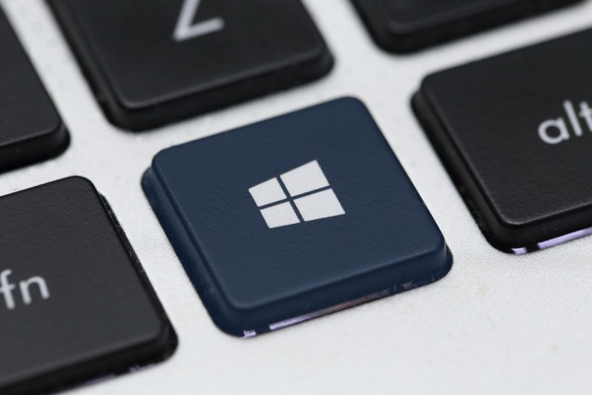
Windows 10 Anniversary
Will be available Summer 2016 as part of CB, CBB will be established sometime after CB release (as customary part of “flighting”)
Key innovations include:
Windows Hello for Apps & Microsoft Edge
Windows Ink (integration with apps like Maps, Edge, Office) & developers incorporate Ink functionality into custom apps
Cortana improvements and app collection in the store (over 1,000 Cortana-enabled apps)
UWP apps for Xbox via Unified Windows Store & Xbox One as a dev kit (Windows 10 Anniversary available for Xbox One)
Support for Hololens
https://blogs.windows.com/windowsexperience/2016/03/30/windows-10-anniversary-update-brings-new-experiences-and-developer-opportunity/

Slide 8



Windows “Flighting”
Consumers
Updates installed regularly via Windows Update when they arrive
Large and diverse user base helps drive quality of the OS updates
BYOD devices are up to date & secure
Business Users
Middle ground between regular new features and stability
Providing the frequent consumer updates combined with IT control
Provides the best choice for the vast majority of business uses
Special Systems Examples: Air traffic control or emergency rooms
No new features provided outside of long term releases
Regular security updates; control via WSUS
How many existing business systems have been treated in the past

Slide 9
Windows Branching
* * * * * * * * * * * * * * * * * * * * * * * * * * * * * * * * * * * * * * * * * * * * * * * * * * * * * * * * * * * * * * * * * * * * * * * * * * * * * * * * * Windows Features over Time
Feature Upgrade: A Cumulative Upgrade package that updates a Windows 10 instance with the latest new features, experiences and capabilities on to, as well as components of previously released servicing updates.
Feature Upgrade Packages are also what is used to install Windows 10 on previous versions of Windows, or devices with no OS.
Feature Upgrade “ XXXX ”
F
Windows Servicing Branch “#1”
“Current Branch/Current Branch for Business”
F
S
S
S
CBB
S
S
S
S
S
S
S
Microsoft plans to release Feature Upgrades to
Servicing Branch “#1” two to three times per year
Feature Upgrade “ ZZZZ ”
F
F
Windows Servicing Branch “#2”
“ Long Term Servicing Branch”
S
S
S
S
S
S
S
S
S
S
S
S
S
S
S
S
S
S
S
S
S
S
Microsoft plans to release Feature Upgrades to
Servicing Branch “#2” every two to three years (Two to three times per decade)
TechNet Library Topic: Windows 10 servicing options for updates & upgrades http://aka.ms/windows10servicing

Slide 10
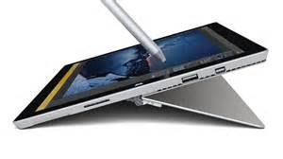
Digital Ink
Increase productivity by incorporating writing (inking) into the computing experience (70% of people spend more than 1 hour a day using a pen)
An all-new experience that enables writing on a device as if it was on paper; creating notes, drawing on a whiteboard, and sharing “analog thoughts”
Part of Windows 10 Anniversary Update (expected in Summer 2016 for CB)
Windows Ink is integrated into apps like Maps, Microsoft Edge, and Office
Microsoft also announced a partnership with Wacom to create and produce Windows Ink capable solutions for the ecosystem
Simultaneous pen and touch is turned on by default, an app can receive both touch and pen input streams via existing Windows Pointer APIs (WM_POINTER and PointerPoint for Win32 & UWP).
Leverage Windows Ink to handle input types by using InkPresenter, CoreWetStrokeUpdatedSource to manipulate ink, as well as GestureRecognizer to detect and process touch gestures.
https://blogs.windows.com/windowsexperience/2016/03/30/the-future-of-pen-windows-ink/
https://blogs.windows.com/buildingapps/2016/04/06/create-ideate-and-collaborate-build-apps-powered-by-windows-ink/

Slide 11



Bots & Conversation
Microsoft is planning on conversational bots as the future of computing, and the next big platform to be tackled by technology
Can replace web interfaces that currently use forms to gather information and instead leverage a conversation approach to gather the same information
The inorganic processes through which we use computers now, will one day be replaced with ordinary conversations powered via bots (“conversation as a platform”)
Microsoft has announced the Microsoft Bot Framework, which is a toolkit that allows developers to create chatbots to replace traditional interfaces
Leverages conversation, AI, analytics and the power of the web to connect experiences together that drive the bots to interact with the user.
https://dev.botframework.com/
http://mspoweruser.com/microsoft-introduces-bot-framework/

Slide 12
Bot CodING DEMO

Slide 13
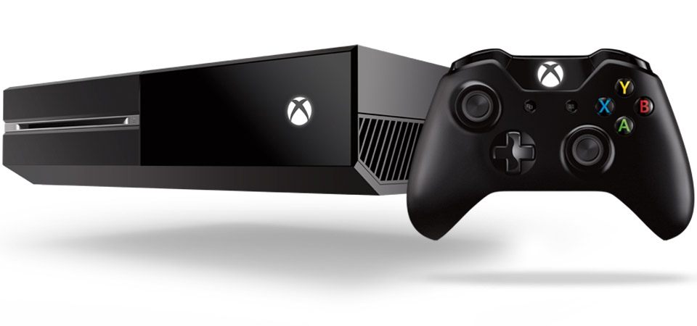
XBox Dev Mode
XBox Dev Mode will help developers create apps or games for the Xbox One (unlocks the XBox retail to use for development & testing)
Build & experiment with UWP to test apps and games in a living room scenario
Beginning with Windows 10 Anniversary Update (summer 2016), Xbox & Windows store will be unified
Anniversary Update will also bring Cortana to XBox One

Slide 14

IoT announcements
Azure IoT Starter Kits announcement
5 new kits to make IoT more accessible
Azure IoT Gateway SDK in Azure IoT Hub
Enables developers to build & deploy modules for edge intelligence to optimize and process data before it’s sent to the cloud
Device Management in IoT Hub
Admins can enroll, view status & health, organize, control access, update firmware & software, and configure IoT devices (uses the LWM2M protocol)
http://blogs.microsoft.com/iot/2016/04/04/azure-iot-at-build-2016/
https://azure.microsoft.com/en-us/develop/iot/starter-kits/
https://azure.microsoft.com/en-us/blog/microsoft-announces-two-new-offerings-to-streamline-iot-management

Slide 15
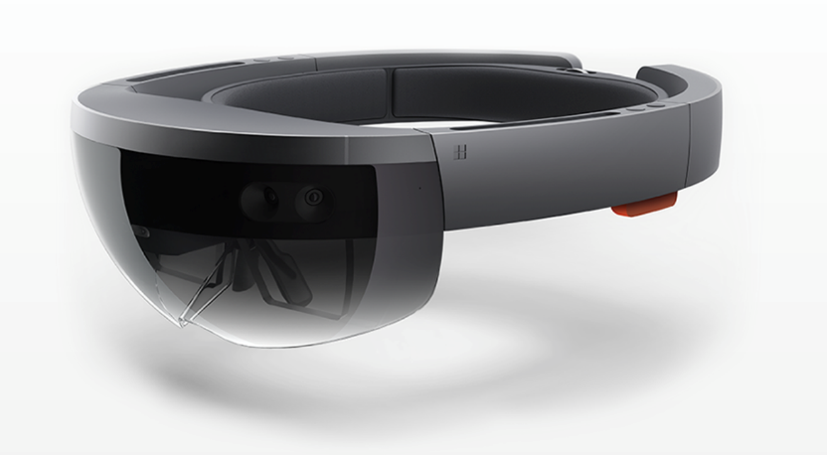
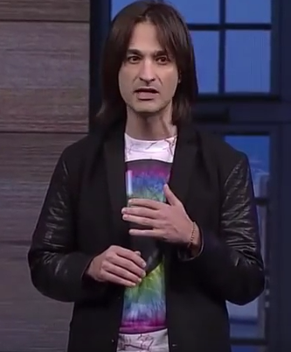

Hololens
First wave of Hololens devices (Developer Edition) are shipping to developers!
Costs $3,000
Requires Windows Insider
must apply to get into program
https://www.microsoft.com/microsoft-hololens/en-us/developers

Slide 16
.NET CORE
.NET CORE is a slimmed down version of .NET Framework
Designed to run on Windows/Linux/Mac
ASP.NET CORE 1 is ASP.NET built on .NET Core (kinda)
https://github.com/dotnet/core
https://blogs.msdn.microsoft.com/webdev/2016/01/19/asp-net-5-is-dead-introducing-asp-net-core-1-0-and-net-core-1-0/

Slide 17

Service Fabric
Deploy and Maintain Microservices
Target Azure, AWS, Linux, Windows
https://azure.microsoft.com/en-us/services/service-fabric/
https://azure.microsoft.com/en-us/documentation/articles/service-fabric-overview/

Slide 18
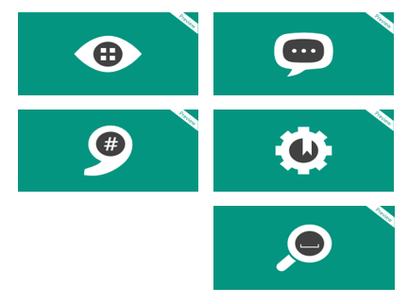
Microsoft Cognitive Services
Enable natural and contextual interactions with tools that augment user’s experiences by leveraging machine-based AI
Build apps with powerful algorithms by literally using a few lines of code that work across devices and platforms (iOS, Android, Windows)
Microsoft provides APIs (currently in Preview) for:
Vision (Computer, Emotion, Face and Video)
Speech (speech to text and back, recognition)
Language (spell check, understanding, analysis, text, model)
Knowledge (academics, linking, exploration, recommendations)
Search (autosuggest, image, news, video, web)
https://azure.microsoft.com/en-in/services/cognitive-services/
https://www.microsoft.com/cognitive-services/en-us/apis
https://github.com/Microsoft/ProjectOxford-clientsdk

Slide 19
Cognitive Services Demo

Slide 20
Questions

